Slide 1
ForestGEO plants
Made by Ian McGregor May 2019
This is meant to be a help guide for the ForestGEO plot, with specific, anecdotal ways of identifying the different species we have.

Slide 2
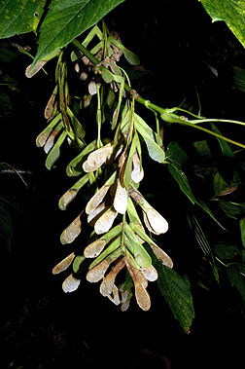
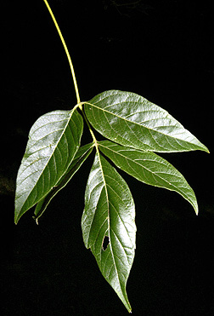
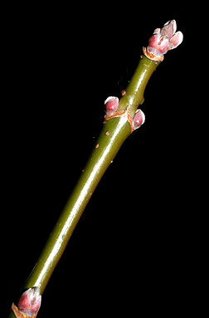
Acer negundo
Boxelder
Fruit is light-tan samaras, drooping clusters
New growth stems are green! And warty
Leaves variably shaped, opposite, pinnately compound
Variable leaf shape
3-5 leaflets, when in 3s, can look like tree version of Toxicodendron radicans (poison ivy)
http://dendro.cnre.vt.edu/dendrology/syllabus/factsheet.cfm?ID=3

Slide 3
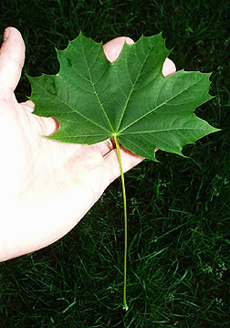
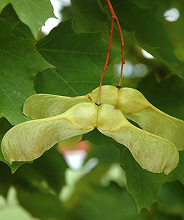
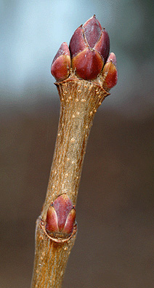
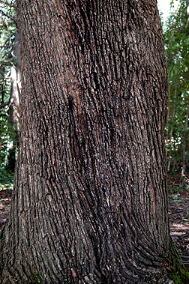
Acer platanoides
Norway maple
Invasive
Bark shallowly furrowed (older)
Buds are green, but mature purple
Fruit = wide divergent, winged samara, bright yellow-green
Leaves are obnoxiously maple
Much more pointed than A. rubrum
Palmate, 5-7 lobes
Milky sap from petiole when detached
Can also be purple (cultivar)
http://dendro.cnre.vt.edu/dendrology/syllabus/factsheet.cfm?ID=6

Slide 4
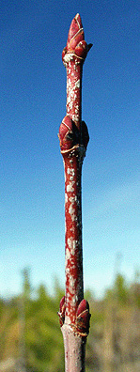
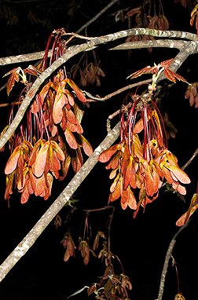
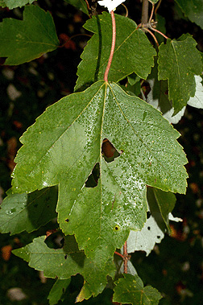
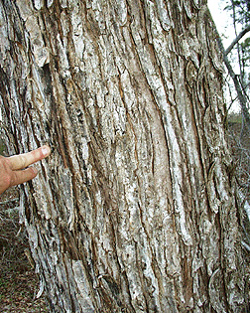
Acer rubrum
Red maple
Bark smooth and light grey young, otherwise darker and breaks up into long, fine scaly plates
Buds reddish and lustrous with small lenticels
Fruit is light brown to reddish samaras on long stems
Leaves opposite, have red petioles
3 lobes, toothed, pale underside
http://dendro.cnre.vt.edu/dendrology/syllabus/factsheet.cfm?ID=1

Slide 5
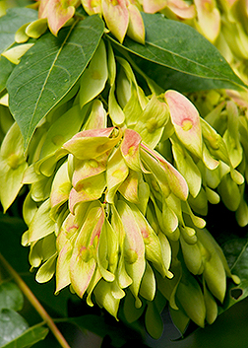
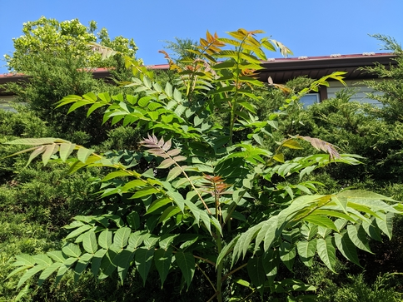
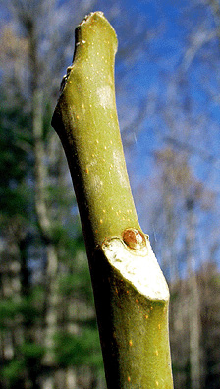
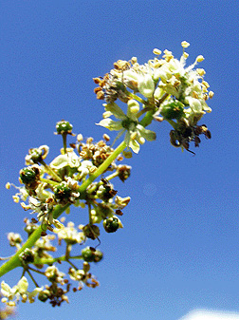
Ailanthus altissima
Tree of heaven
Invasive
Fruit is twisted samara, in long clusters
Twigs stout, yellow to red-brown, large reddish pith inside
Chunky bark, lower branches tend to droop
Resprouts like willow, aka wherever, whenever, whatever
Compound, opposite leaflets
1-3 ft long! 11-41 leaflets!
Newest growth is more purply-red
Teeth at leaf bases
http://dendro.cnre.vt.edu/dendrology/syllabus/factsheet.cfm?ID=7

Slide 6
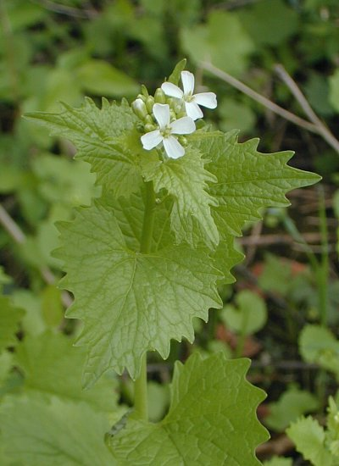
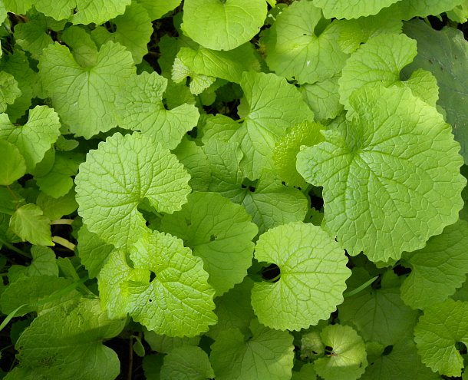
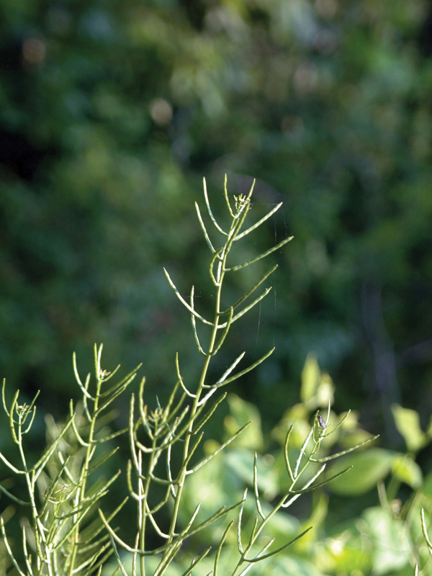
Alliaria petiolata
https://www.illinoiswildflowers.info/weeds/plants/garlic_mustard.htm
Garlic mustard
Invasive
Stems and petioles sometimes hairy
Plant grows straight up
Upper stems terminate with white flowers
After maturity, long, thin seed pods form
Leaves dependent on year
1st year: Small rosette of leaves, rounded, heart-shaped-ish
2nd year: alternate, coarse serration, sometimes wavy margins, upper leaves oval
Veins easily noticeable
Young leaves good on salads!!
1st year
2nd year
https://emswcd.org/on-your-land/weeds/weeds-to-know/garlic-mustard/garlicmustard4/

Slide 7
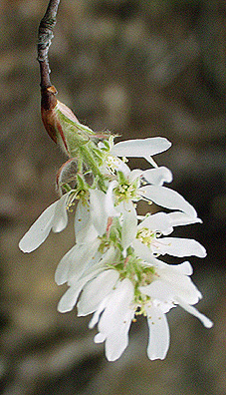
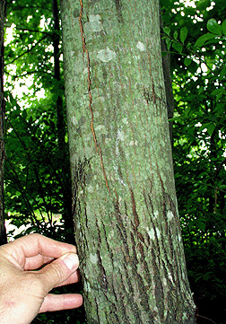
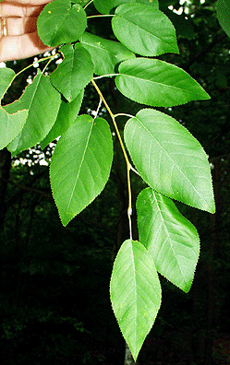
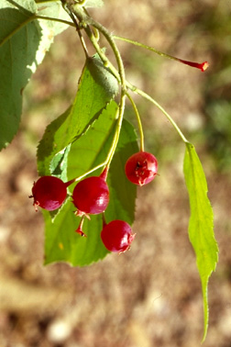
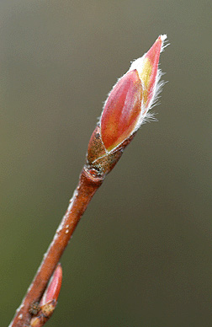
Amelanchier arborea
Downy serviceberry
Small, red to purple berries, mid summer, edible(!)
Buds are pointed, have hairy margins, light yellow-green to red
Showy white flower in drooping bunches
Bark smooth when young, ashy grey with darker stripes, then becomes rough with vertical splits and furrows
Leaves are alternate, finely serrated
Slender petiole, can be fuzzy below, pinnately veined
Hang down from stem, look fragile

Slide 8
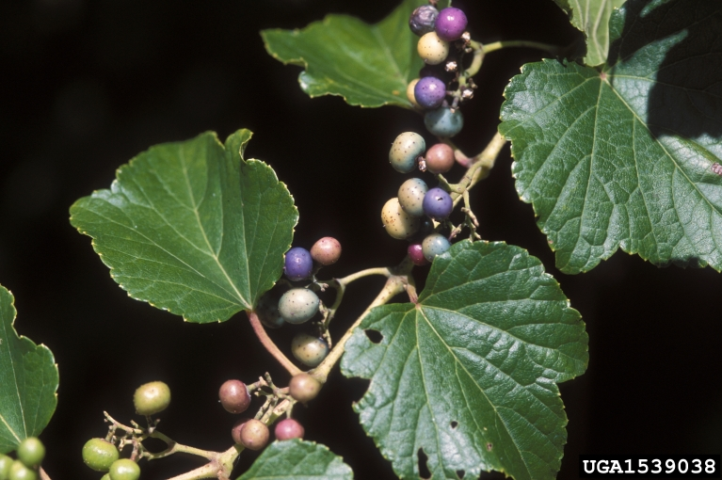
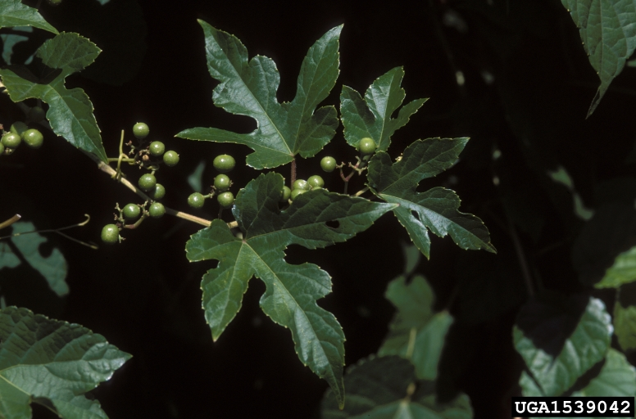
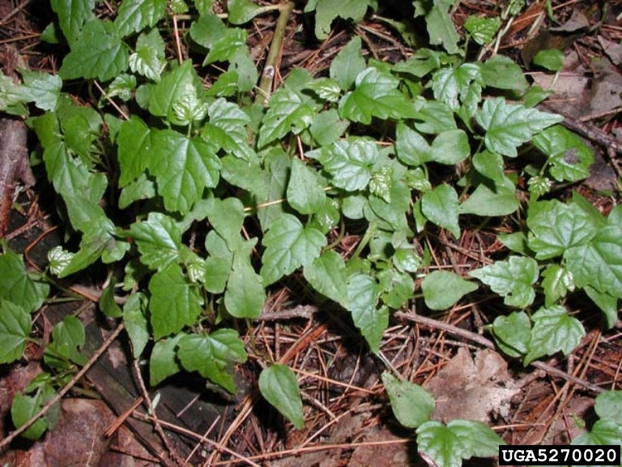
Ampelopsis brevipedunculata
Porcelain-berry
Invasive
Woody vine, lenticel dots
Tiny flowers, clustered
Fruit = spotted white to blue-purple (almost looks like tiny grapes)
Leaves alternate, shallow to deeply lobed (can look like mulberry [Morus spp])
Hair on veins ONLY
https://www.invasiveplantatlas.org/subject.html?sub=3007

Slide 9
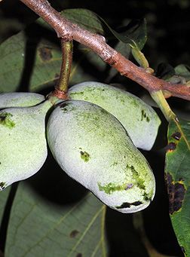
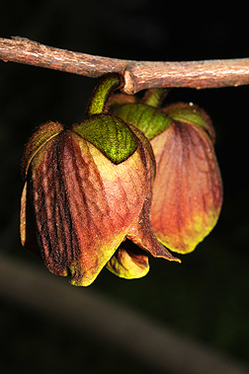
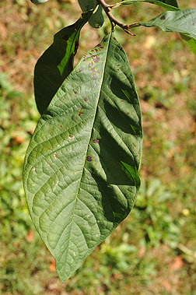
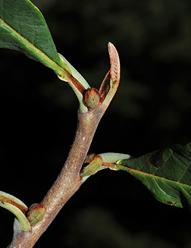
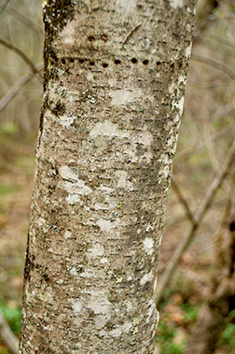
Asimina triloba
Pawpaw
Grows in thickets
Older bark can have wart-like lenticels, sometimes light grey patches
Fruit is lumpy, fat banana, ripe when soft, edible
Flowers look like dark purple bells, hang down off twigs (spring)
Leaves alternate, large, entire, wavy-ish
Short petiole
Many straight parallel veins, short tapered
http://dendro.cnre.vt.edu/dendrology/syllabus/factsheet.cfm?ID=155

Slide 10
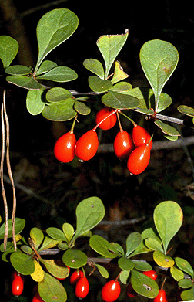
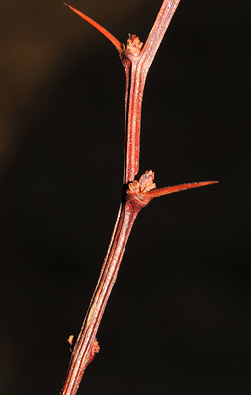
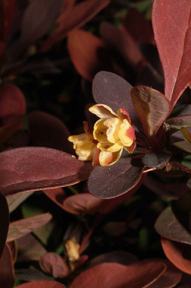
Berberis thunbergii
Japanese barberry
Invasive
Fruit is small red berry, ripen in fall
Flowers are tiny, pale yellow, normally in clusters
Small, rounded leaves
Only midvein is prominent
Small thorns at base of leaves (each node)
Red to purple fall color
http://dendro.cnre.vt.edu/dendrology/syllabus/factsheet.cfm?ID=374

Slide 11
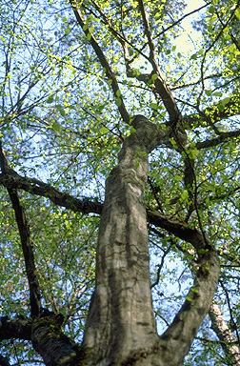
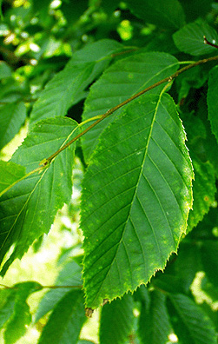
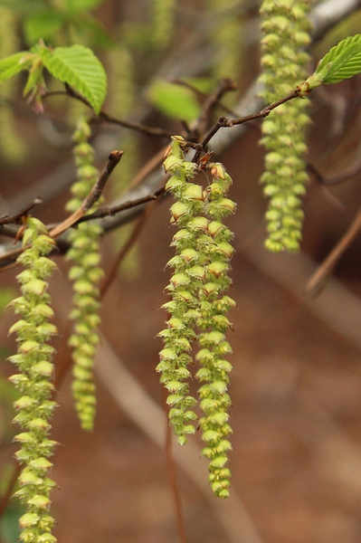
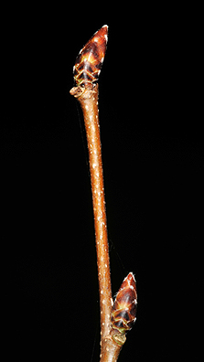
Carpinus caroliniana
American hornbeam
Female flowers look like shaggy catkin
Buds are brown and angled
Leaves look like Fagus grandifolia but are double toothed and sharper
Alternate, green petiole
Very smooth grey bark, some blue
Trunk looks like sinewy muscle (other common name is musclewood)
Small tree, doesn’t grow very tall
http://dendro.cnre.vt.edu/dendrology/syllabus/factsheet.cfm?ID=17

Slide 12
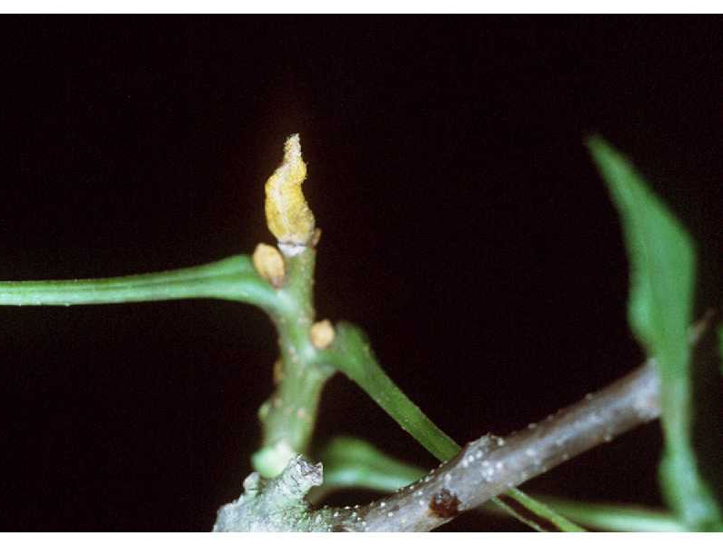
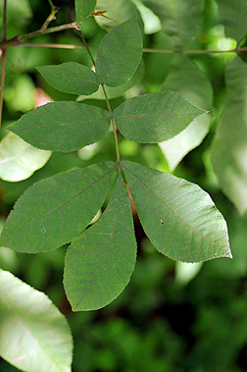
Carya cordiformis
Butternut hickory
5-11 leaflets
Sulfur (yellow) buds
http://dendro.cnre.vt.edu/dendrology/syllabus/factsheet.cfm?ID=18
Source: https://plants.usda.gov/core/profile?symbol=CACO15

Slide 13
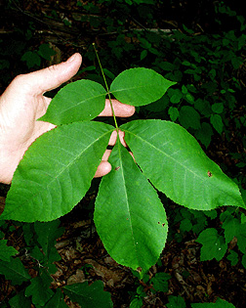
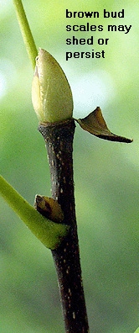
Carya glabra
Pignut hickory
5 leaflets (rarely 7), entire
Glabrous (NOT hairy)
Hairless leafstalk and petiole
ONLY has green petioles
All Carya widest toward tip
Source: http://dendro.cnre.vt.edu/dendrology/syllabus/factsheet.cfm?ID=19

Slide 14
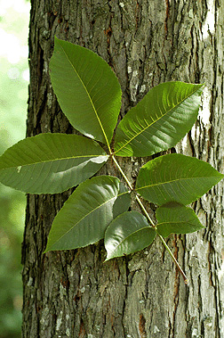
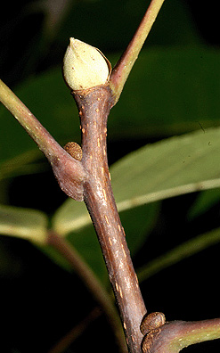
Carya ovalis
Sweet pignut hickory
7 leaves (less often 5 or 9)
Petiolule green to red/brown at base
Often not hairy
Source: http://dendro.cnre.vt.edu/dendrology/syllabus/factsheet.cfm?ID=826

Slide 15
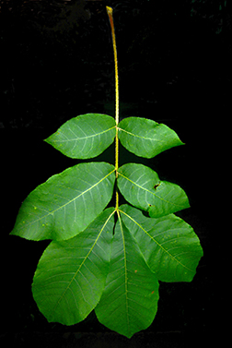
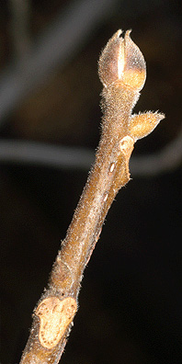
Carya tomentosa
Mockernut hickory
7-9 leaflets, slightly serrated
Larger than C. glabra
Abaxial side is fuzzy
Leafstalk/petioles hairy also
Diamond interlace bark (esp. young)
http://dendro.cnre.vt.edu/dendrology/syllabus/factsheet.cfm?ID=22

Slide 16
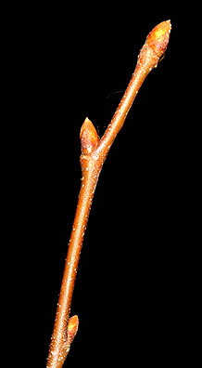
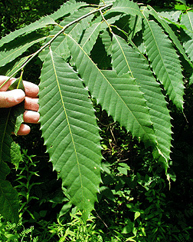
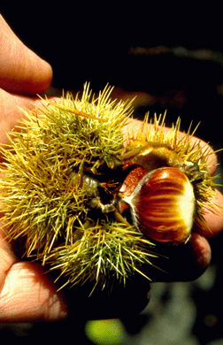
Castanea dentata
American chestnut
Rarely gets tall because of blight
Fruits are spiky but have chestnut
Twigs hairless
Looks like F. grandifolia leaves but much sharper
And bigger! Large leaves
Short petiole, alternate
http://dendro.cnre.vt.edu/dendrology/syllabus/factsheet.cfm?ID=21

Slide 17
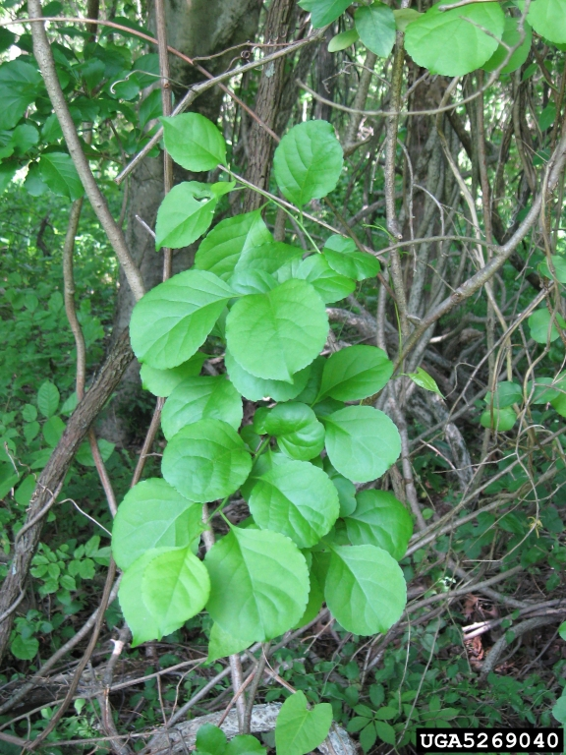


Celastrus orbiculatus
Oriental bittersweet
Invasive
Woody vine, some furrows, perennial
3-7 yellow flower clusters
Red fruit (like tiny berries)
Leaves alternate, shallow teeth, <2x long as wide
Pointed tip but rounded when mature
Leaves fold at midvein
https://www.invasiveplantatlas.org/subject.html?sub=3012

Slide 18




Celtis occidentalis
Hackberry
Bark has “warts”, developing into rough, corky, irregular ridges
Twigs light red-brown with light lenticels (not as big as Lindera benzoin)
No terminal bud, lateral buds are small, triangular, tan, hug stem
Fruit is small, dark purple (ripe) berry, edible!
Leaves alternate, simple, serrated
Unequal base, sometimes fuzzy leaf
3 distinct veins originate from base
http://dendro.cnre.vt.edu/dendrology/syllabus/factsheet.cfm?ID=26

Slide 19



Cercis canadensis
Eastern redbud
Brilliant purple/pink flowers in spring, pea-like
Fruits are flattened dried legumes (looks like flat vanilla)
Twigs conspicuously red-ish and small white lenticels
Heart-shaped leaves
Entire, tapered, alternate, hanging
http://dendro.cnre.vt.edu/dendrology/syllabus/factsheet.cfm?ID=43

Slide 20




Chionanthus virginicus
Fringetree
Flowers spindly and white, showy, fragrant
Fruit dark blue to black berries
Twig has scattered warty lenticels
Leaves grow upwards from apical meristem
Bigger leaves may droop a bit
Opposite, entire, pale below, prominent midvein
Conspicuous white hairs underneath, shortish petioles
Leaves feel leathery
http://dendro.cnre.vt.edu/dendrology/syllabus/factsheet.cfm?ID=27

Slide 21




Cornus alternifolia
Alternate-leaf dogwood
Looks exactly like C. florida EXCEPT multiple leaves come out of single point, which are arranged alternately along stems
Berries are black-blue
Twigs are red to dark-purple
Young bark is smooth, dark-green, streaky
http://dendro.cnre.vt.edu/dendrology/syllabus/factsheet.cfm?ID=146

Slide 22



Cornus florida
Flowering dogwood
Flowers have four notched bracts, either white or pink
Red, clustered berries
Bark tends to be broken in square pattern
Leaves come out of same point 2 at a time, opposite to each other, and opposite on stem
Feel leathery-ish
Veins curve to follow leaf shape
http://dendro.cnre.vt.edu/dendrology/syllabus/factsheet.cfm?ID=44

Slide 23





Corylus americana
American hazelnut
Shrub
Leaves fuzzy, alternate
2+ leaves every node
Finely serrated, double-toothed
Prominent veins abaxial
Small lenticels on bark
Fruit is edible (brown nuts) encased in leaf-like husk
http://dendro.cnre.vt.edu/dendrology/syllabus/factsheet.cfm?ID=208

Slide 24


Crataegus spp
Hawthorn
Usually dense shrubs, can be small tree
All Crataegus have thorns on twigs/near leaves
Leaf shapes highly variable
Alternate, lobed or unlobed
Dark green above, paler below
In plot, we had 1 C. pruinosa tagged, but it is since dead. There are a few C. spp. alive, and randomly scattered.
http://dendro.cnre.vt.edu/dendrology/syllabus/factsheet.cfm?ID=45

Slide 25




Diospyros virginiana
Common persimmon
Flat checkerboard, scaled bark (very unique), like charcoal briquettes
Leaves alternate, short petiole
Glossy green above, can see all veins easily
Stalks and petioles green
Only a couple individuals in the plot
http://dendro.cnre.vt.edu/dendrology/syllabus/factsheet.cfm?ID=29

Slide 26

Elaeagnus umbellata
Autumn-olive
Invasive
Shiny, silvery on undersides of leaves, pale green on top
Grows as shrub to small tree, and can take over area
Originally planted at SCBI for erosion control on hillsides
http://dendro.cnre.vt.edu/dendrology/syllabus/factsheet.cfm?ID=269

Slide 27




Euonymus alatus
Winged euonymus
Invasive
Brilliant red fall color
Stems grow in tight bunches
New growth can look like it has thorns
Simple leaves, finely serrated
Opposite, simple (although they look like compound)
Glossy, almost feels oily below
Prominent midvein, otherwise other veins not seen well
Conspicuous wings on twigs
http://dendro.cnre.vt.edu/dendrology/syllabus/factsheet.cfm?ID=282

Slide 28


Fagus grandifolia
American beech
Bark is smooth, thin, grey
Alternate, each vein ending in sharp, distinct tooth
Waxy, shiny green above, slightly paler below
Browned leaves will often persist through winter
http://dendro.cnre.vt.edu/dendrology/syllabus/factsheet.cfm?ID=47

Slide 29


Fraxinus americana
White ash
Longest petioles of the three Fraxinus we have in plot
Very circular leaves
Whitened undersides
Slightly hairy
Rich purplish or reddish-brown fall color
http://www.uwgb.edu/biodiversity/herbarium/trees/fraxinus_comparison01.htm
http://dendro.cnre.vt.edu/dendrology/syllabus/factsheet.cfm?ID=46

Slide 30


Fraxinus nigra
Black ash
NO petioles (sessile)
More pinnate leaves than F. americana
No whitened underside
Mostly restricted to wetter sites
Mostly yellow fall color
http://www.uwgb.edu/biodiversity/herbarium/trees/fraxinus_comparison01.htm
http://dendro.cnre.vt.edu/dendrology/syllabus/factsheet.cfm?ID=173

Slide 31


Fraxinus pennsylvanica
Green ash
Barely has a petiole
Not really whitened underside
Mostly yellow fall color
http://www.uwgb.edu/biodiversity/herbarium/trees/fraxinus_comparison01.htm
https://www.dendroapp.frec.vt.edu/VT_Assets/Fact_Sheets/images/Fraxinus%20pennsylvanica/twig1.jpg

Slide 32



Hamamelis virginiana
Witch-hazel
Fuzzy buds, flimsy yellow flowers
Leaves alternate, rounded, with rounded teeth
Lop-sided base
Shrub to small tree, multi-trunked
Largest one we saw was >27 stems (in SNP)
http://dendro.cnre.vt.edu/dendrology/syllabus/factsheet.cfm?ID=50

Slide 33





Heracleum mantegazzanium
Giant hogweed
TOXIC (lethal) DO NOT TOUCH
Invasive
White flowers with 50-150 rays, like umbrella
7-14 feet tall
Huge leaves, deeply lobed, to 5 feet across
Stems are green with purple splotches, prominent white hairs
Seeds are flat, dry, oval with brown lines
NOT IN PLOT – here for reference because it has been found in Warren County
If you are unsure about identification, please see the NY DEC website for other pictures and common misidentifications
https://www.dec.ny.gov/animals/72766.html

Slide 34


Ilex opaca
American holly
Typical holly
Leaves are glossy, sharp thorned
Only plant that has leaves like this in area
http://dendro.cnre.vt.edu/dendrology/syllabus/factsheet.cfm?ID=51

Slide 35


Ilex verticillata
Winterberry holly
Deciduous holly!
Could be confused with L. benzoin if just glancing, but bark no have lenticels
Often grow in small thickets with multiple stems
Small leaves, no thorns
Tiny, sharp serrations
Multiple leaves often grow from same point
http://dendro.cnre.vt.edu/dendrology/syllabus/factsheet.cfm?ID=270

Slide 36




Juglans cinerea
Butternut
Fruit is longer than it is wide
Leaves are densely hairy underneath, hairs are branched (stellate)
Leafstalk has sticky hairs
Leaf scar has hair on top edge
http://dendro.cnre.vt.edu/dendrology/syllabus/factsheet.cfm?ID=31

Slide 37




Juglans nigra
Black walnut
Fruit is spherical
Leafstalk and petioles are short pubescent
Short hairs on undersides along vein ribs
Hairs are simple (not branched)
http://dendro.cnre.vt.edu/dendrology/syllabus/factsheet.cfm?ID=32

Slide 38




Juniperus virginiana
Eastern redcedar
Berry-like cones, light green in spring, turning dark blue when mature in fall
Bark is red-brown, exfoliating in long fibrous strips, sometimes ashy-grey where exposed
Two main types of leaves
Dark blue-green needle-like leaves (sharp) often on young trees and fast-growing shoots
Scale-like, more atypical juniper leaves, 4 sides tightly held to twig
http://dendro.cnre.vt.edu/dendrology/syllabus/factsheet.cfm?ID=97

Slide 39



Lindera benzoin
Spicebush
Shrub to small tree, very rapidly takes over an area
Bark has small, light-colored lenticels
Small yellow flowers in spring
Leaves can be very small to almost half a hand
Alternate, simple, elliptical, entire
When crushed, strong spice smell (like allspice)
Red berry fruit also has this smell (can be dried and used for allspice)
http://dendro.cnre.vt.edu/dendrology/syllabus/factsheet.cfm?ID=123

Slide 40



Liriodendron tulipifera
Tulip-poplar
Unique leaves, alternate
Showy, large, yellow, tulip-like flowers
Fruit is shaggy cone of samaras
Tallest trees in plot
Bark has many white furrows
http://dendro.cnre.vt.edu/dendrology/syllabus/factsheet.cfm?ID=54

Slide 41


Lonicera japonica
Japanese honeysuckle
Invasive
Twisting vine
Normal honeysuckle flowers
Opposite leaves, simple, entire
http://dendro.cnre.vt.edu/dendrology/syllabus/factsheet.cfm?ID=153

Slide 42



Lonicera maackii
Amur honeysuckle
Invasive
Can be large shrub, multi-stemmed, drooping shape
Leaves simple, opposite, tapered tip, slightly fuzzy below
Fruits are red juicy berries
Flowers look/smell like typical honeysuckle
http://dendro.cnre.vt.edu/dendrology/syllabus/factsheet.cfm?ID=268

Slide 43


Microstegium vimineum
Japenese stiltgrass
Invasive
Elongated leaves, alternate
NO RIPPLES (smooth)
Not too glabrous
Thin leaves
Ground cover
https://plants.usda.gov/core/profile?symbol=MIVI

Slide 44

Nyssa sylvatica
Blackgum
Greenish twigs become red-brown to grey
Older bark checkered, chunky, deep furrows
Fruit is berries in small bunches (3+)
Leathery leaves, variable in shape (entire to random serrations)
Alternate, short petiole
Multiple leaves from one point
http://dendro.cnre.vt.edu/dendrology/syllabus/factsheet.cfm?ID=60

Slide 45



Oplismenus undulatifolius
Wavyleaf basketgrass
Invasive
Small, glabrous, ripples across leaves
Hairy stems
https://www.invasiveplantatlas.org/subject.html?sub=79593

Slide 46



Ostrya virginiana
American hophornbeam
Young seed pods white-green, clustered, flat (looks like hops, hence the name)
Mature in late summer, then turn brown and persist through winter
Young bark very much like Prunus (white lenticels, smooth-ish)
Twigs are reddish with white lenticels
Old bark shaggy
Leaves stiff, alternate, double-toothed, sharp (bristles on tips)
Hairy, green petioles, green and plastic-y feel above, paler and fuzzy/orange tinge below
Bud at nodes
Wavy margin, leaves folded at midvein, hang down from twig
This particular individual (2 total) is at Rappahannock County Public Library. This is currently not located in the ForestGEO plot.
Pictures and identification from Ian McGregor, with verification from http://dendro.cnre.vt.edu/dendrology/syllabus/factsheet.cfm?ID=62

Slide 47


Parthenocissus quinquefolia
Virginia creeper
Bright red fall color
Tendrils from vine are much heftier than T. radicans (poison ivy)
Look like hard lab bug feet that you don’t want on you
Leaves alternate, coarse toothed
Palmately compound in 5s (like Rubus allegheniensis)
http://dendro.cnre.vt.edu/dendrology/syllabus/factsheet.cfm?ID=126

Slide 48



Paulownia tomentosa
Princess / Empress tree
Invasive
Showy flowers and fruits (oval capsules, sound like wind chimes)
Very fuzzy leaves
Also very large leaves
Heart-shaped
http://dendro.cnre.vt.edu/dendrology/syllabus/factsheet.cfm?ID=145

Slide 49

Persicaria perfoliata (Polygonum perfoliatum)
Mile-a-minute
Invasive
Grows very quickly (~6 in./day)
Fruits look like tiny berries
Annual vine
Small, trident leaves
Stems have thorns/prickles
Small discs at nodes
http://nyis.info/invasive_species/mile-a-minute/

Slide 50


Pinus pungens
Table mountain pine
Bark is scaly, dark red-brown or grey, developing irregular plates with very scaly surface
Needles in groups of 2, twisted like P. virginiana
Sharp-tipped
Cones have thick, curved spines in all directions
Often grow in whorls
Cones are closed
NOT IN PLOT
http://dendro.cnre.vt.edu/dendrology/syllabus/factsheet.cfm?ID=114

Slide 51


Pinus strobus
Eastern white pine
Cones are longer, more slender, not stiff
Bark reddish-brown to grey-brown with furrows/ridges
Needles in groups of 5, can appear blue-green
Thinner than P. virginiana
http://dendro.cnre.vt.edu/dendrology/syllabus/factsheet.cfm?ID=111

Slide 52


Pinus virginiana
Virginia pine
Small cones, sessile
Bark is orange-brown and scaly (young) to cinnamon colored patches (older)
Needles in groups of 2
Twisting! They look like they’re not fully straight
In plot, the only 2 tagged P. virginiana are too tall to see needles
http://dendro.cnre.vt.edu/dendrology/syllabus/factsheet.cfm?ID=113

Slide 53


Platanus occidentalis
Alternate, palmately-veined, typical sycamore shape
Zigzagging twigs, large tree
Bark is mottled brown, green, tan, white
Camouflage bark that easily exfoliates
http://dendro.cnre.vt.edu/dendrology/syllabus/factsheet.cfm?ID=36

Slide 54



Prunus avium
Sweet cherry
Invasive
Leaves not as dark/glossy as P. serotina
Coarser serrations
Fruit is sweet
Bark is much more like typical cherry (large horizontal lenticels encircling trunk).
In plot, have large P. avium with easily recognizable bark
Bark can also peel
http://dendro.cnre.vt.edu/dendrology/syllabus/factsheet.cfm?ID=63

Slide 55


Prunus serotina
Black cherry
Younger bark has typical cherry lenticels, older bark has “burnt cornflakes” (irregular upturned plates)
Fruit looks like tiny cherries, dark purple to black
Shiny, dark green leaves, oblong to lance-shaped
Small, sharp serrations
http://dendro.cnre.vt.edu/dendrology/syllabus/factsheet.cfm?ID=66

Slide 56


Quercus alba
White oak
Leaves have rounded lobes, no points
Bark is flaky-ish, very light in color
Source: http://dendro.cnre.vt.edu/dendrology/syllabus/factsheet.cfm?ID=35

Slide 57


Quercus coccinea
Scarlet oak
NOT IN PLOT, included for comparison
Deep acorn cup
Buds have whitish hairy tip
Leaves most closely resemble Q. palustris
Main difference is extra lobes at tops
Small tufts white hair where veins meet midvein
Source: http://dendro.cnre.vt.edu/dendrology/syllabus/factsheet.cfm?ID=37

Slide 58


Quercus falcata
Southern red oak
Only 1 specimen in plot
Uneven lobes
Very hairy abaxially (undersides)
Spines at lobe tips like other oaks
Source: http://dendro.cnre.vt.edu/dendrology/syllabus/factsheet.cfm?ID=68

Slide 59


Quercus michauxii
Swamp chestnut oak
Was the same species as Q. prinus but then split based on range
Leaves are very similar to Q. prinus
Main difference is Q. michauxii generally has fuzzy leaf undersides
Source: http://dendro.cnre.vt.edu/dendrology/syllabus/factsheet.cfm?ID=243

Slide 60


Quercus muehlenbergii
Chinkapin oak
NOT IN PLOT, included for comparison
Leaves also with scrapbook scissors, but a little more irregular and sharp tips
Green petioles, slight hairs
Small hairs abaxial
Small leaves compared to our other oaks
Source: http://dendro.cnre.vt.edu/dendrology/syllabus/factsheet.cfm?ID=244

Slide 61


Quercus palustris
Pin oak
NOT IN PLOT, included for comparison
NOT hairy
Lobes are more rounded than Q. falcata and almost touch midvein
Drooping leaves, hair at midvien
Not as many tip lobes as Q. coccinea
Shallow acorn caps
Source: http://dendro.cnre.vt.edu/dendrology/syllabus/factsheet.cfm?ID=74

Slide 62


Quercus prinus (=Q. montana)
Chestnut oak
More common at SCBI than Q. michauxii (because this is the range of it)
Leaves look like used scrapbook scissors
Source: http://dendro.cnre.vt.edu/dendrology/syllabus/factsheet.cfm?ID=76

Slide 63


Quercus rubra
Northern red oak
Shallow acorn caps
Bark is reddish inside with shallow fissures
Hairless buds and hairless adult leaves
Alternate veins
Long and droop from twig tips
Leafstalk (petiole) green to red
Source: http://dendro.cnre.vt.edu/dendrology/syllabus/factsheet.cfm?ID=38

Slide 64


Quercus stellata
Post oak
NOT IN PLOT, included for comparison
Narrow lobes, rounded tips
Fat leaf area
“looks like drunk Q. alba”
Source: http://dendro.cnre.vt.edu/dendrology/syllabus/factsheet.cfm?ID=77

Slide 65



Quercus velutina
Black oak
Acorns have deep cup
Hairy adult leaves and hairy, green petioles
Sun leaves often smaller and have very deep lobes
Also drooping like Q. rubra
Easy to confuse with Q. rubra if can’t touch the leaves
Bark is irregular and blocky
Interior bark is yellow!
Source: http://dendro.cnre.vt.edu/dendrology/syllabus/factsheet.cfm?ID=39

Slide 66


Rosa multiflora
INVASIVE
Can grow to dense thickets
White flowers with yellow center
Alternate, pinnately compound
Thorns curve up like scythe, will hook on to clothing and skin
5-11 serrated leaflets
Source: http://dendro.cnre.vt.edu/dendrology/syllabus/factsheet.cfm?ID=151

Slide 67




Robinia pseudoacacia
Black locust
Compound, alternate leaves
Entire, dull blue-green, 7-19 leaflets, each 1.5”
Fruit pods like flattened snap pea cases
Flowers small, pea-like (Fabaceae), hanging in 6” clusters
Thorns on stems and twigs, rugged bark
Much more outside the plot (along adjacent to Leach lake on road and on Leach road)
Source: http://dendro.cnre.vt.edu/dendrology/syllabus/factsheet.cfm?ID=40

Slide 68

Rubus allegheniensis
Allegheny blackberry
NOT AS COMMON IN PLOT
5 leaves come out of central point
Tapered, serrated
Longer petioles
Alternate compound
Stalk can be large with large spines
Source: http://dendro.cnre.vt.edu/dendrology/syllabus/factsheet.cfm?ID=139

Slide 69

Rubus pensilvanicus
Pennsylvania blackberry
Alternate compound leaves
Terminal leaves the largest
3 leaves per leaflet
Coarse serration
Alternate veins
Source: https://www.invasive.org/browse/detail.cfm?imgnum=5386474

Slide 70

Rubus phoenicolasius
Wineberry, Wine raspberry
Small red raspberries
Leaves are very pale below
Thorns are red
Leaves arranged similar to R. pensilvanicus but larger
Very prickly-hairy stems
Stems are very red
Source: http://dendro.cnre.vt.edu/dendrology/syllabus/factsheet.cfm?ID=319

Slide 71


Sassafras albidum
Sassafras
Pale green undersides, fuzzy
Leaves are variably shaped (some like mittens)
Small dark berries from red stems
Small clustered flowers with new leaves in spring
Bark with deep furrows
Source: http://dendro.cnre.vt.edu/dendrology/syllabus/factsheet.cfm?ID=84

Slide 72

Sambucus canadensis
American black elderberry
Compound, opposite leaflets
Flat-topped clusters of flowers
Stems are very light
NOT common in plot
https://plants.usda.gov/core/profile?symbol=sanic4

Slide 73


Smilax rotundifolia
Common greenbrier
Thorns stick straight out, NOT hooked
Grows haphazardly as vine or tangled bush
Leaves alternate, simple, rounded
Shiny green above, like glossy
New growth good for salads
http://dendro.cnre.vt.edu/dendrology/syllabus/factsheet.cfm?ID=127

Slide 74



Symphoricarpos orbiculatus
Coralberry
Deciduous shrub, up to 4’ tall
In plot, often very small
Middle to upper branches reddish purple to brown and sometimes hairy
Fruits are clustered coral-colored berries
Leaves opposite, looks like Lonicera japonica but not a vine
Upper surface may have leaves
Lower is whitish-green and can be hairy
Short petioles
https://plants.usda.gov/core/profile?symbol=SYOR
https://www.illinoiswildflowers.info/savanna/plants/coralberry.htm
https://www.wildflower.org/plants/result.php?id_plant=syor

Slide 75

Tilia americana
American basswood
Alternate leaves
Sharp-ish serrations, pointing up
Inward base, pointing up like Cercis canadensis
Prominent veins abaxially, whitish (underside)
Tapered tip
Most of the ones in the plot are taller adult trees

Slide 76


Toxicodendron radicans
Poison-ivy
Everything about this plant is poisonous. If handling, use gloves / use Technu
Vine is very hairy, much more noticeable when older
Scraggly hairs when younger
Differs from P. quinquefolia because these hairs are thinner/fragile
Leaves alternate, in 3s, variably shaped (irregular toothed)
Shiny green above
http://dendro.cnre.vt.edu/dendrology/syllabus/factsheet.cfm?ID=128

Slide 77


Ulmus americana
American elm
Hairy leaves underside, alternate, simple
Fruit (seeds) hairy on margins
Spongy bark when young, then dark ashy grey
Twigs glabrous
There has been confusion about this vs U. rubra in the plot. It’s hard to find seeds, but in the census we have majority U. rubra. Noone is certain, though.
http://dendro.cnre.vt.edu/dendrology/syllabus/factsheet.cfm?ID=41

Slide 78


Ulmus rubra
Slippery elm
Leaves hairy, noticeably uneven bases
Seeds are NOT hairy
Twigs are mucilaginous when chewed
Bark is dark reddish-brown, inner is mucilaginous
There has been confusion about this vs U. Americana in the plot. It’s hard to find seeds, but in the census we have majority U. rubra. Noone is certain, though.
http://dendro.cnre.vt.edu/dendrology/syllabus/factsheet.cfm?ID=42

Slide 79

Viburnum acerifolium
Mapleleaf viburnum
Looks like small maple leaves but NO RED STEM
Opposite leaves and very fuzzy
We don’t have many of these tagged in the census, but there are many of these in the deer exclosure (esp the SW part) as small shrubs
Source: http://dendro.cnre.vt.edu/dendrology/syllabus/factsheet.cfm?ID=91

Slide 80


Viburnum prunifolium
Blackhaw
Large shrub or small tree
Bark looks like alligator hide
Look like cherry leaves
BUT are opposite (Prunus is not opposite)
Most common Viburnum in ForestGEO census
Source: http://dendro.cnre.vt.edu/dendrology/syllabus/factsheet.cfm?ID=129

Slide 81

Viburnum recognitum (=V. dentatum)
Arrowwood
Very fuzzy leaves like V. acerifolium
Opposite
Basically it’s like you took V. acerifolium leaves and got rid of the lobes
Also not really in ForestGEO census, but definitely present in deer exclosure
Source: http://dendro.cnre.vt.edu/dendrology/syllabus/factsheet.cfm?ID=357

